Slide 1

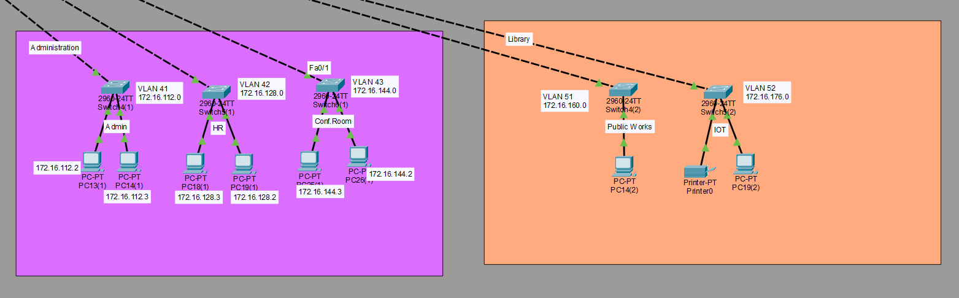
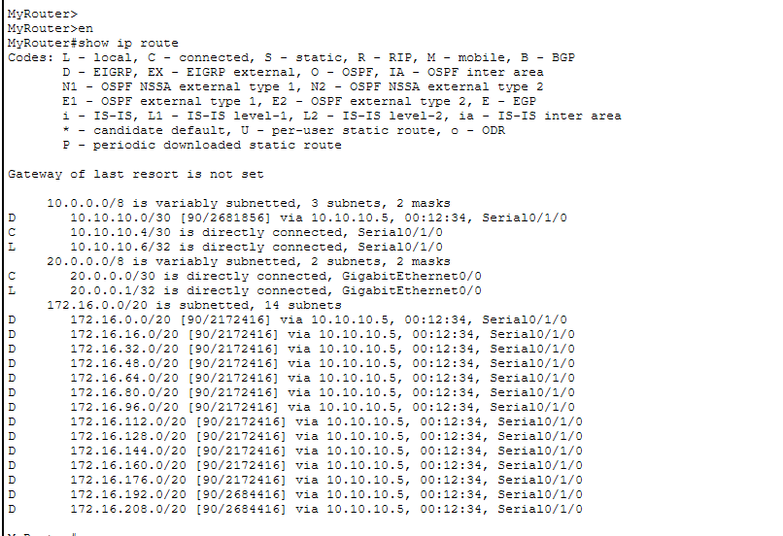
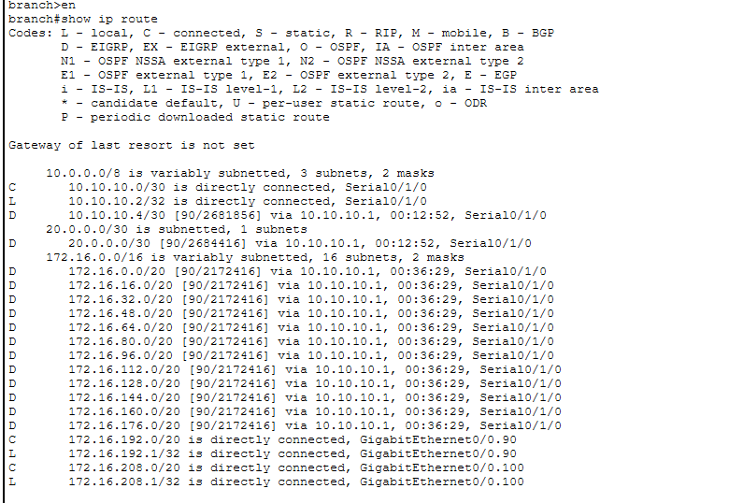
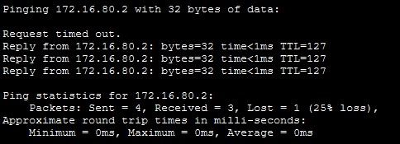
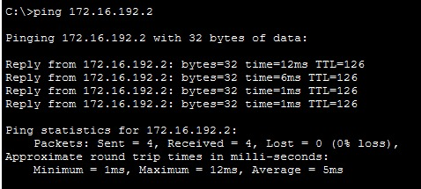
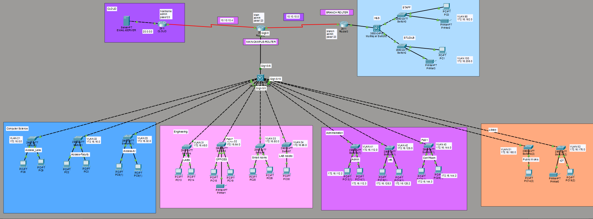
CSE261- Computer Networks
A New Technical College Campus
Student Names:
Menna Allah Osama Khalil Khalil Ibrahim23102157 Arwa Mohey Hamdy Aboalia 23101371 Rodina bakr 23101390 Sondous Adel Metwalli Ibrahim Ali Eid 23101396 Rawan Osama fares 23101891 Basmala Tarek Mahmoud Elkady 23101372 Ethar Ahmed Mohamed 23101369
Supervised by:
Dr. Essam Abdellatef
Problem
Modern educational institutions rely heavily on computer networks to support academic, administrative, and research activities across multiple departments, laboratories, and buildings. As the number of users, devices, and services continues to grow, managing network traffic efficiently becomes increasingly challenging. Without proper network segmentation, structured routing, and strong security controls, institutions face problems such as network congestion, unauthorized access, security vulnerabilities, and unreliable connectivity.
The main challenge is to design a unified campus network that can securely and efficiently connect different departments, administrative offices, laboratories, and branch campuses while maintaining high performance and availability. The network must support diverse user groups, including students, faculty members, staff, and public users, and be scalable enough to accommodate future expansion and technological advancements.
Goal
The main goal of this project is to design and implement a complete campus network infrastructure for a technical college that:
Supports multiple buildings and departments.
Separates traffic using VLANs and subnetting.
Provides secure inter-VLAN and inter-campus communication
Connects a branch campus and external cloud services.
Ensures reliability, scalability, and centralized management.
Approach
Technologies used
A hierarchical network design with core, distribution, and access layers was used to ensure efficient connectivity. VLANs and structured IP subnetting were implemented to separate departments and user groups, while multilayer switches enabled inter-VLAN routing and WAN links connected the main campus, branch campus, and cloud services. Security was strengthened using a firewall and access controls, and the entire network was designed and validated in Cisco Packet Tracer with successful connectivity testing.
Cisco Packet Tracer
Cisco Routers (2911)
Cisco Multilayer Switches (3560)
Cisco Access Switches (2960)
VLANs & Trunking
Inter-VLAN Routing
Static / Dynamic Routing
DHCP Services
ACLs for Traffic Control
Z
Results and Conclusion
This project delivered a scalable and secure campus network design that meets institutional needs and follows industry best practices. By combining hierarchical architecture, VLAN segmentation, and effective routing, the network provides a solid foundation for future expansion and enhanced services.

